Slide 1
SECURITY and PRIVACY Issues in the INTERNET ( A View From Law Enforcement)
Africa Internet Governance Forum 2016 16-18th October, 2016 Durban, South Africa.
By MICHAEL ILISHEBO, ZAMBIA POLICE SERVICE, ZAMBIA.

Slide 2
OUTLINES
Introduction
Definitions
Security vs Privacy
Encryption
Security and Privacy – A Compromise
Recommendations
Conclusions

Slide 3
1. INTRODUCTTION
The most important job of governments is to “secure the general welfare” of its citizens. Security is a common good that is promised to all citizens, and it must outweigh any personal concerns about privacy.
The security concerns in this digital area from all types of threats such as Cyber Terrorism, Cyber Warfare, Cyber Crimes etc. have outstretched the capacity of most African governments both in financial and human capacity. There is no single country on the African continent that can claim of a safer cyber space today due to the borderless nature of these threats.

Slide 4
Law Enforcement Agencies (LEA) on the continent are now faced with a gigantic task of combating these cyber threats. However, despite the “DIGITAL DIVIDE” between LEA’s and bad actors online (cyber criminals), efforts are being made to bridge the divide despite a 100 step difference.
In the quest to make our cyber space free of criminality, the battle between Security and Privacy come crushing against each other.

Slide 5
2. Definitions
SECURITY (National)
Security is the state of being free from danger or threat..
PRIVACY (Personal)
Privacy is the ability of an individual or group to seclude themselves, or information about themselves, and thereby express themselves selectively.

Slide 6
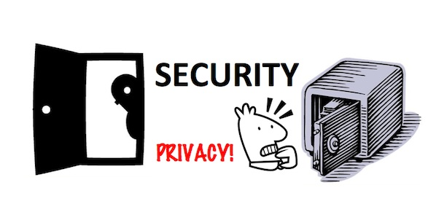
3. Security vs Privacy

Slide 7
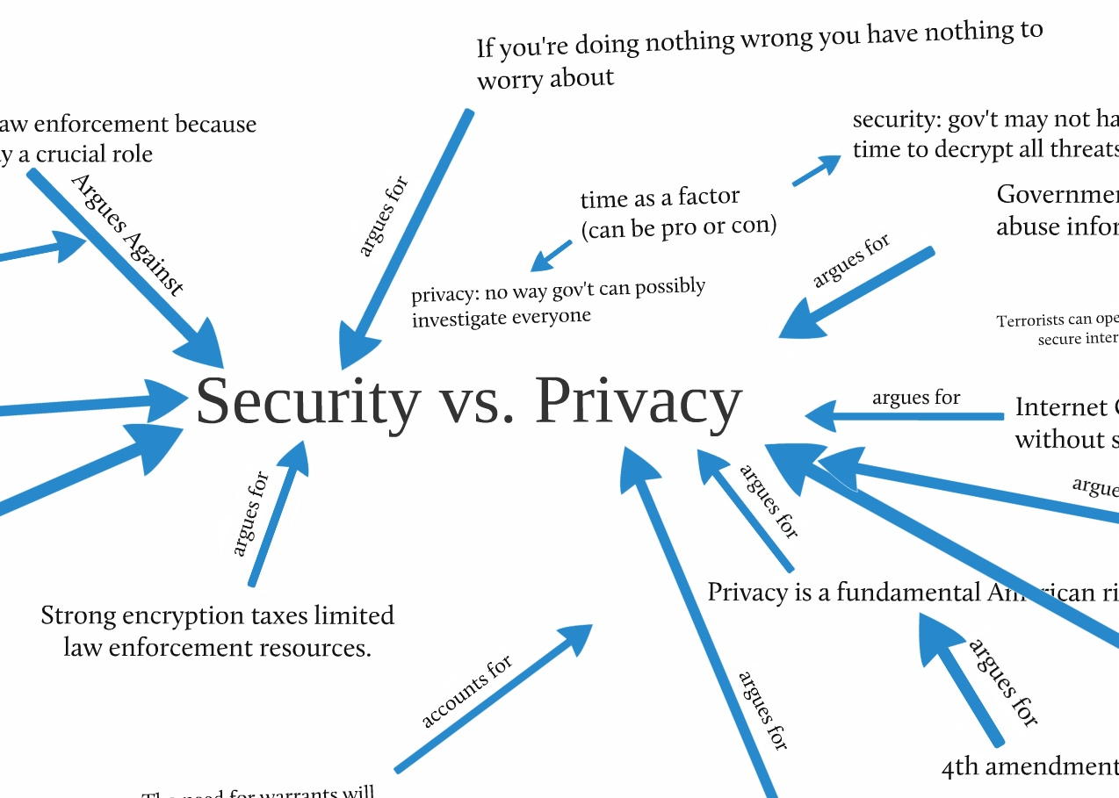

Slide 8
The 2013 Snowden Revelations and the 2016 FBI vs Apple case have brought back to the limelight the issue of Security vs Privacy online.
For the most part, when governments talk about security, it’s about protecting the general public from threats--foreign and domestic. The goal isn't to make money or exude trust among it’s citizens, but rather to stop the bad guys from doing bad things.
The tension in security and privacy is not limited to law enforcement and individuals. Corporations are also facing the security – privacy tension. For example, studies have consistently shown that one of the biggest security threats facing companies is from insiders, employees who misuse or abuse rights they are given to do their jobs. Furthermore, courts have held companies liable for misuse of their IT resources, leading many organizations to monitor their employees' use of e-mail and the Internet.

Slide 9
4. Encryption – (Enabler or Inhibiter)
Encryption is defined as the conversion of electronic data into another form, called cipher text, which cannot be easily understood by anyone except authorized parties.
The primary purpose of encryption is to protect the confidentiality of digital data stored on computer systems or transmitted via the Internet or other computer networks.

Slide 10
Encryption has boosted privacy among internet users. It has become the best form of securing their data. However, despite the important role encryption plays, criminals have adopted it’s use in their commission of crime on the internet.
During the course of investigations, many Law Enforcement Agencies in Africa have encountered a ‘concrete’ barrier that stands between their efforts in collecting information. Encryption has proved to be a barrier to information gathering.
The recent FBI vs Apple case (USA) has exposed the standoff between Privacy vs Security.
Encryption can become an enabler or inhibiter depending on which side of the fence you are standing.

Slide 11
5. Security and Privacy – A Compromise
In the quest to reconcile the two sides of the same problem, the question at hand is how to use technology responsibly to make citizens safe without compromising their privacy.
If security solutions do emerge that can reconcile the cross-purposes of security and privacy, they will come from those who have an acute understanding of all the issues. The challenge is to develop a new mind-set, where security and privacy are complementary, not opposites. To achieve this, it will have to take both parties take a ‘win win’ (Fifty Fifty) situation where no other side feels undermined.

Slide 12
6. Recommendations
In the quest to finding a striking balance between Privacy vs Security, among the recommendations should include:
Capacity Building for Law Enforcement Agencies in the area of Internet Governance.
Adopt a Multistakeholder model when addressing security issues affecting citizens.
Use of the internet in a responsible manner, while respecting and upholding the rights of other users.
Advocate for cyber legislations that respects the privacy of the citizens while being cognizant of the importance of security.
Use of encryption services responsibly

Slide 13
7. Conclusion
Clearly, we benefit from both privacy and security. But we need to sacrifice at least some privacy when living with others in an interconnected world. However, proportional some privacy you sacrifice, do not allow the government to abuse it.
Striking the right balance between the sometimes competing ideals of privacy and security will be a challenge for governments and their citizens.
We all deserve to live in a secure interconnected world, but there are some sacrifices we need to make. Let us learn to trust our governments.

Slide 14
THE END..

